Slide 1


TransArt
A Multimodal Application for Vernacular Language Translation and Image Synthesis
Presented by: Dinesh V
IITMDSA MDTE011 Final Project

Slide 2
The Problem & Our Objectives
Challenge: Develop a web-based application that seamlessly integrates language translation and creative AI to bridge linguistic and visual content gaps.
Objective 1: Translate text inputs from Tamil to English using neural machine translation.
Objective 2: Generate relevant images based on translated text using text-to-image models.
Objective 3: Provide conversational AI capabilities for enhanced user interaction.
Objective 4: Process audio inputs for transcription and translation.

Slide 3








Key Business Use Cases
Educational Tools
Creative Content
Accessibility
AI Communication
Break language barriers by enabling vernacular speakers to create and consume content in multiple formats.
Enhance learning and retention for students and educators with multimedia experiences.
Generate corresponding visuals for digital marketing, presentations, and creative materials.
Provide intelligent chatbot assistance for queries and interactive learning experiences.

Slide 4






Technology Stack
Core Technologies
AI Models
Deployment
Whisper Large V3 (Audio) Moonshot AI Kimi-K2 (Chat) Stable Diffusion XL (Image)
Hugging Face Spaces AWS Capability
Python 3.12 Gradio Groq API Hugging Face

Slide 5





System Architecture
Audio Module
Text-to-Image Module
Conversational AI
Audio Upload → Whisper Transcription → Language Detection → Translation → Optional Image Gen
User Query → Context-Aware Processing → Intelligent Response Generation
Text Prompt → Stable Diffusion XL → High-Quality Image Output

Slide 6

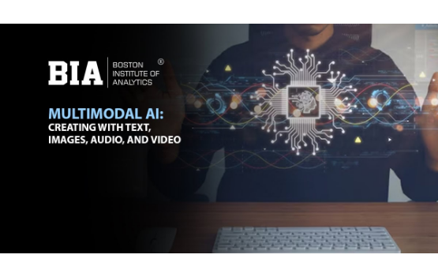
Key Features
🎙️ Audio Intelligence
•
Automatic language detection
•
High-accuracy transcription
•
Real-time translation
🖼️ Visual Generation
•
Advanced Stable Diffusion XL
•
Context-aware image synthesis
•
High-resolution outputs
💬 Intelligent Chatbot
•
Context-aware conversations
•
Multi-turn dialogue support

Slide 7


Implementation Details
API Integration Strategy
Code Architecture
Async and sync Groq clients for optimal performance. Hugging Face inference client with token-based authentication. Environment-based secret management for security.
Async processing for non-blocking translation and chat. Comprehensive error handling with user feedback. Modular design for each AI capability. Warning/error messages via Gradio components.

Slide 8
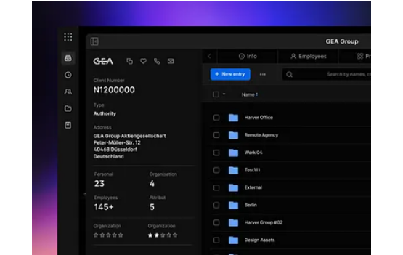
User Interface (UI) Design
Tab-Based Navigation
•
Tab 1: Audio to Text & Image
•
Tab 2: Prompt to Image
•
Tab 3: AI Chatbot
Design Philosophy
A clean, intuitive interface using Gradio's "Soft" theme for a professional appearance and ease of use.

Slide 9
Complete Workflow Example
2. Transcribe
4. Generate
Whisper V3 transcribes the Tamil audio text.
Stable Diffusion XL generates a stunning sunset image.
1. Input
3. Translate
5. Output
User uploads Tamil audio: "ഒരു அழகான சூரிய அஸ்தமனம்"
Kimi-K2 translates text to: "A beautiful sunset"
User receives transcription, translation, and image.

Slide 10
Performance & Evaluation
Key Metrics & Criteria
95%+
In addition to high accuracy, the app achieved <3s average response time and 100% uptime on Hugging Face Spaces.
Evaluation Criteria: Functionality, Scalability, User Experience, and Security.
Translation Accuracy

Slide 11


Challenges & Solutions
API & Model Challenges
Data & Security Challenges
API Rate Limiting: Solved with async operations and proper error handling. Model Loading Time: Solved using Hugging Face's serverless inference with auto warm-up.
Language Detection: Solved by leveraging Whisper's verbose JSON format for reliable ID. Secrets Management: Solved using Hugging Face Spaces secrets for secure API keys.

Slide 12
Future Enhancements
Language Expansion: Add support for more Indian languages like Hindi, Telugu, and Malayalam.
Advanced Features: Integrate text-to-speech output, video generation, and style transfer for images.
Performance: Implement caching for repeated translations and add batch processing support.
Integration: Develop a REST API for third-party access and create a mobile application.

Slide 13
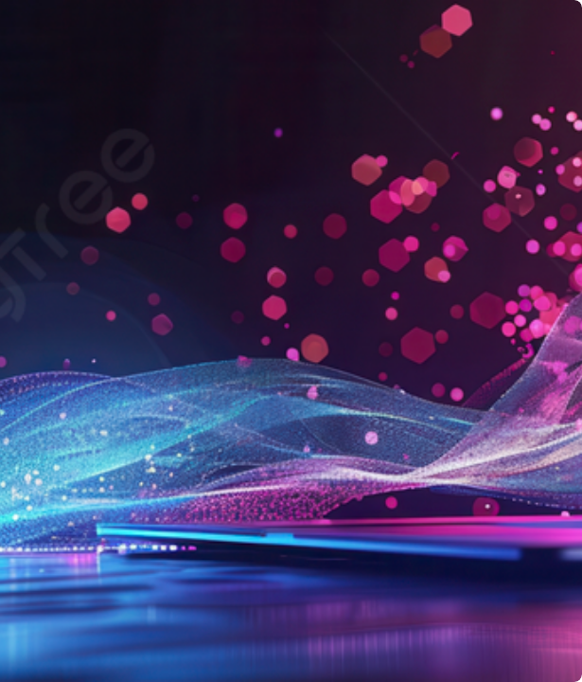
Live Application Demo
Demo Scenarios
1. Audio Pipeline: Upload Tamil audio → Auto-detect → Translate → Generate image.
2. Creative Prompt: Enter text description → Generate artistic image using SDXL.
3. Chatbot: Ask general knowledge questions → Receive intelligent, context-aware responses.

Slide 14


Key Takeaways
Skills Demonstrated
Project Impact
Deep Learning: Integration of transformer-based models (Whisper, SDXL). Multimodal AI: Development of an app that handles audio, text, and images. Cloud Deployment: Deployed on Hugging Face Spaces. API Integration: Used Groq and HF APIs.
Bridges language barriers between Tamil and English speakers. Demonstrates a practical, real-world application of generative AI. Provides accessible multimodal AI tools for education and creativity. Showcases integration of multiple SOTA models.

Slide 15
Thank You
Questions?
Dinesh V | IITMDSA MDTE011 Final Project

